Slide 1
Selenium

Slide 2
Version Control and Revision History
 | Name | Date
Prepared By | Karthika | 02-12-2019
Reviewed By
Approved By
Version No. | Date | Affected Sections | Highlights
 |  | ALL | Updated Based on the course sheet coverage

Slide 3








Iconic Representations.......
Test your Memory
Objective
Coffee Break
Can you Solve?
Queries
Recap
Need more Info
Brainstorm

Slide 4
Introduction to selenium
Selenium is a free (open source) automated testing suite for web applications across different browsers(IE 6/7, Firefox, Opera, Safari 2.0+) and platforms (Windows, Linux, and Macintosh).
Selenium allows scripting in several languages like Java, C#, PHP and Python.
Selenium is not just a single tool but a suite of software's, each catering to different testing needs of an organization. It has four components.
Notes:
Preamble :
What is testing ?
ans.> Software testing can be stated as the process of validating and verifying that a computer program/application/product:
i>meets the requirements that guided its design and development,
ii>works as expected,
iii>can be implemented with the same characteristics,
iv> satisfies the needs of stakeholders.
What is automation ?
ans.> Automation in testing is a process to automate the manual test process.
Why automation?
Ans.> In manual testing process we have to perform some testing multiple times. It is time consuming as it have been done manually. To reduce the manual effort and errors we are going for the automation testing. It is time reducing and more error free than manual testing.
Brief overview of automation tools
Ans.> We automate the process using different tools:
1. Selenium
2. QTP
3. Load Runner
etc.

Slide 5
Selenium Components

Slide 6
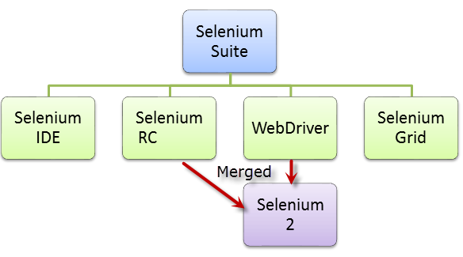
Selenium Architecture
Notes:
Evolution of Selenium:
Selenium is an automation tool for web application.
Selenium have for different type according to its functionality like Selenium IDE, Selenium RC, WebDriver, Selenium Grid.
Selenium IDE →This is basically a plugin. It is supported only by Firefox. It does record and play operation. And it has the privileges to export JUnit code. We also export the code in C#, Python, Ruby.
Selenium RC → - Here we create an server from which the code is executed and result will be shown in requesting machine.
WebDriver → - This is the first cross platform testing framework that could control the browser from the OS level.
Selenium Grid → It is also have the same privileges as Selenium RC. It has more extra features like
1> We can create parallel execution process.
2> We can test the application from different browser at single instance of time
3> It has capable of capturing browser screenshots during significant stages, and also of sending out Selenium commands to different machines simultaneously

Slide 7
Selenium Components
Selenium IDE
A Firefox extension that can automate the browser through a record-and-playback feature.
To further increase the speed in creating test cases

Slide 8
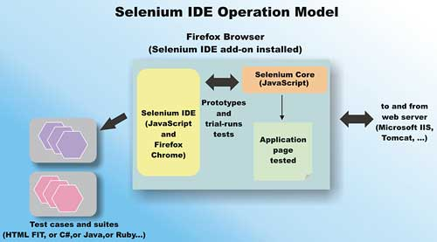
Workflow of Selenium IDE
Notes:
Workflow of selenium IDE:
Selenium IDE records the flow of testing process of an web application in its recommended place called test suit. Then it runs the application according to the recorded process. It only works with Firefox browser. We can also export the process in different language like JAVA, C#, Ruby, Python ,PHP.

Slide 9
Pros & Cons
Selenium IDE
Pros
→ Very easy to use & install.
→ Can export tests to formats usable in selenium RC & WebDriver.
→ Has built- in help & test results reporting module.
→ Provides support for extensions
Cons
Available only in Firefox.
Designed only to create prototypes of test
No support for iteration & conditional operations.
Test execution is slow compared to that of selenium RC & WebDriver.

Slide 10
Selenium Components
Web Driver
when browsers and web applications were becoming more powerful and more restrictive with JavaScript programs like Selenium Core.
It was the first cross-platform testing framework that could control the browser from the OS level.

Slide 11
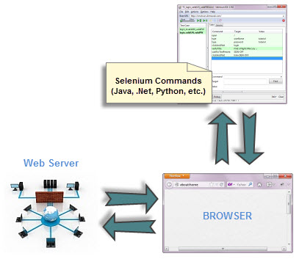

Selenium Web driver
The Web Driver proves itself to be better than both Selenium IDE and Selenium RC in many aspects.
It implements a more modern and stable approach in automating the browser’s actions.
It controls the browser by directly communicating to it.

Slide 12
Pros & Cons
WebDriver
Pros
→Communicates directly to the browser.
→Browser interaction is more realistic
No Need to start a server.
Faster execution time than IDE and RC
Cons
Requires programming knowledge.
Cannot readily support new browsers

Slide 13
Selenium IDE Commands & Locators

Slide 14
Commands
Commands | Features
Actions | These are commands that directly interact with page elements.
Accessors | They are commands that allow you to store values to a variable.
Assertions | They are commands that verify if a certain condition is met. 3 Types of Assertions Assert. When an “assert” command fails, the test is stopped immediately. Verify. When a “verify” command fails, Selenium IDE logs this failure and continues with the test execution. WaitFor. Before proceeding to the next command, “waitFor” commands will first wait for a certain condition to become true.

Slide 15
Synchronization Commands
andWait commands
These are commands that will wait for a new page to load before moving onto the next command.
clickAndWait
typeAndWait
selectAndWait
waitFor commands
These are commands that wait for a specified condition to become true before proceeding to the next command (irrespective of loading of a new page). These commands are more appropriate to be used on AJAX-based dynamic websites that change values and elements without reloading the whole page.
waitForTitle
waitForTextPresent
waitForAlert

Slide 16
Locating elements
Locating by id
Locating by class
Locating by Name
Locating by Xpath
Locating by CSS
Locating by LinkedText
Locating by parcialLinkedText
Locating by DOM
Notes:
<html>
<form id=“loginForm”>
<input type=text name=username />
<input type=password name=password/>
<input type=submit name=continue/>
</form></html>
Identifier=loginForm
Identifier=username
Name=username
Name=password
Id=LoginForm
Xpath=//form[@id=‘loginForm’]
//form[1] = first form element in HTML
//form[input/\@name=‘username’]
//input[@name=‘username’]
//form[@id=loginForm]/input[1]
//input[@name=‘continue’][type=‘submit’] = more than one object match the identification
Link=continue
Link=cancel

Slide 17
For more information please contact: T+ 33 1 98765432 F+ 33 1 88888888 M+ 33 6 44445678 firstname.lastname@atos.net

